Slide 1

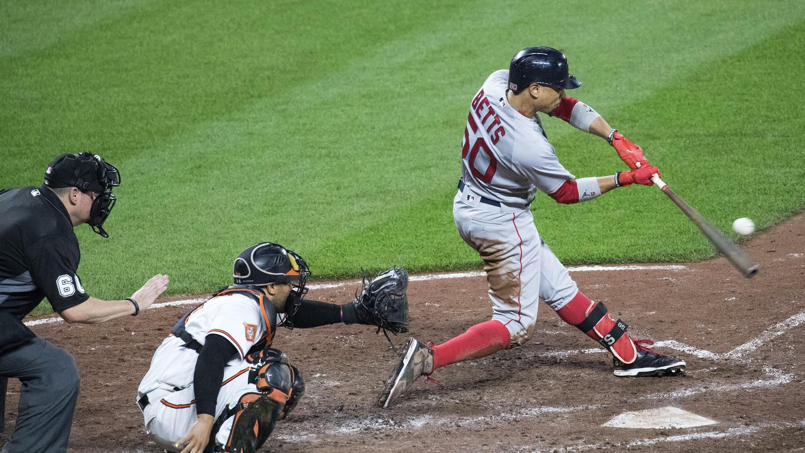


Baseball Draft Perdiction
Going back from 2000 can we discover/predict if a first round pick will help their team make playoffs, win the rookie of the year or how long the player will be in the MLB!

Slide 2

First Round Draft Pick Perdiction
The purpose of this analysis is to see if there is a correlation between longevity and the draft round pick of a major league baseball player.

Slide 3

Questions
Is there a correlation between first round draft picks and the tema makin it to playoffs
Is there a correlation between first round draft picks and longevity in the mlb
Is there a correlation between Rookie of the Year and the team making it to the playoffs.

Slide 4

Stats included
Initial signing salary/bonus
Average annual salary over the length of players career
What awards did the players accumulate
How many games did they play
If the average MLB players career is 4-6 years, how does 1st and 2nd round players compare
What is their overall batting average? What is their length per initial team they were drafted

Slide 5
First year overall stats
Batting average
Player performance
Playoffs
Salary

Slide 6
Tools Used
AWS-
Baseball-reference.com
Jupyter Notebook- to run Pandas and Python

Slide 7

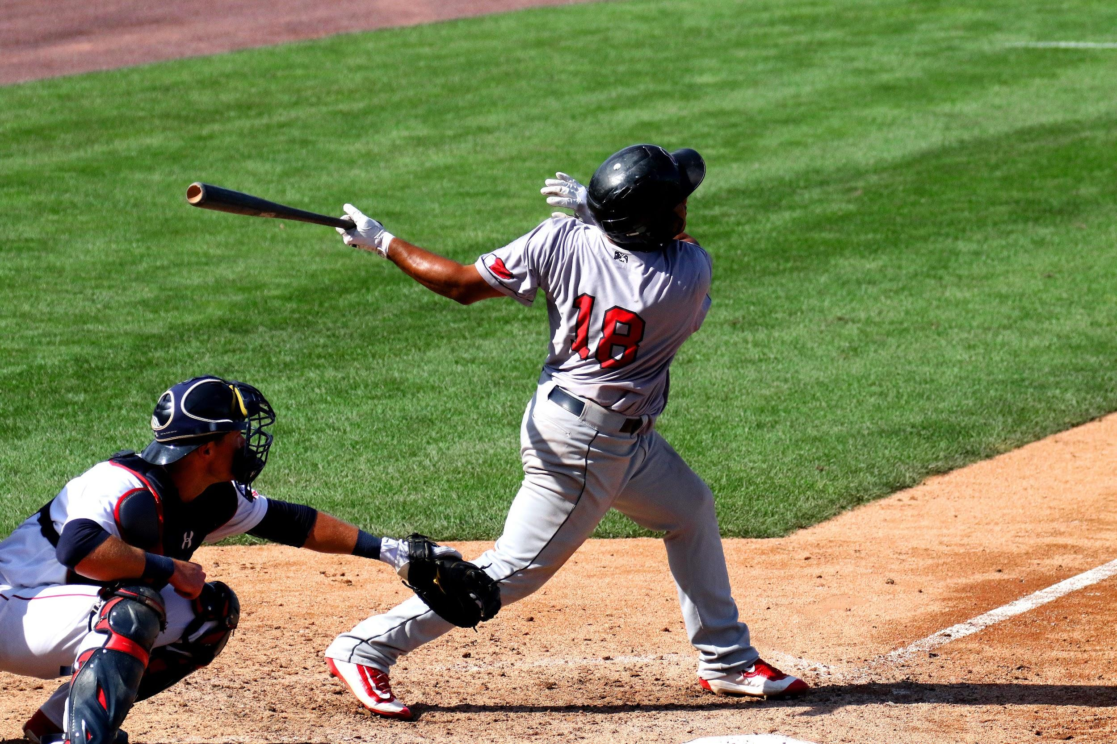







Slide 8


Contact
Your Name
no_reply@example.com
www.example.com

